Slide 1

Tha Calum aon an-diugh.
Notes:
Calum is 1 today.

Slide 2
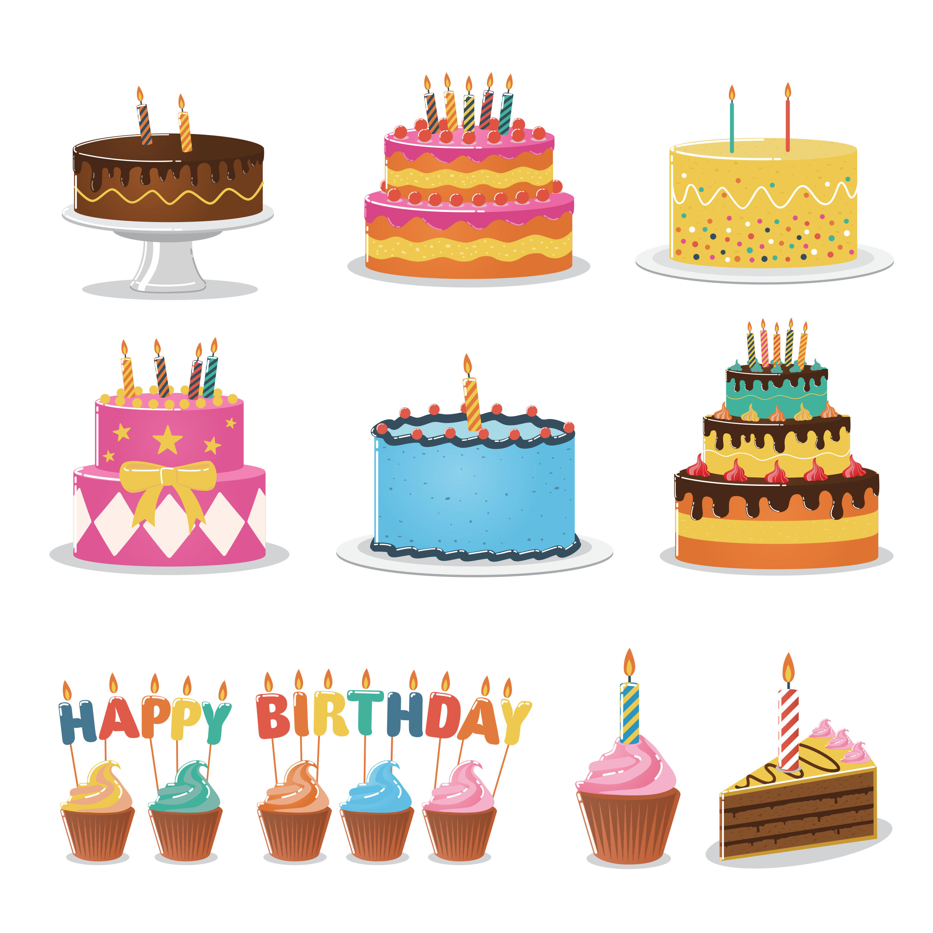
Cia mheud coinneal air a’ chèic?
Aon.
Notes:
How many candles on the cake? 1

Slide 3
Tha Màiri dhà an-diugh.
Notes:
Mairi is 2 today.

Slide 4
Cia mheud coinneal air a’ chèic?
Aon, dhà.
Notes:
How many candles on the cake? 1,2

Slide 5
Tha Iain trì an-diugh.
Notes:
Iain is 3 today.

Slide 6
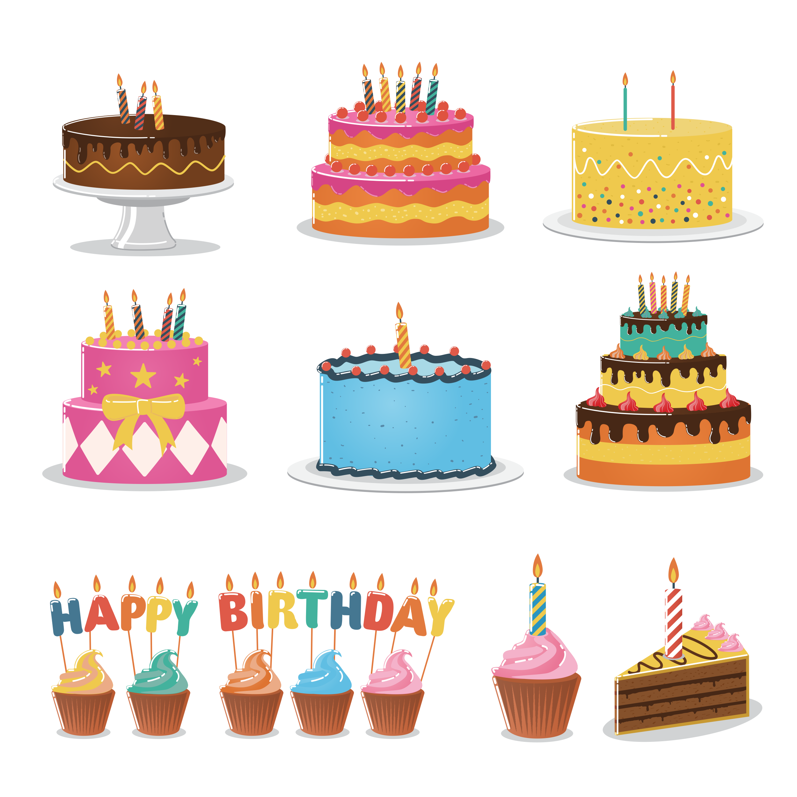
Cia mheud coinneal air a’ chèic?
Aon, dhà, trì.
Notes:
How many candles on the cake? 1,2,3

Slide 7
Tha Eilidh ceithir an-diugh.
Notes:
Eilidh is 4 today.

Slide 8
Cia mheud coinneal air a’ chèic?
Aon, dhà, trì, ceithir.
Notes:
How many candles on the cake? 1,2,3,4

Slide 9
Tha Tòmas còig an-diugh.
Notes:
Thomas is 5 today.

Slide 10
Cia mheud coinneal air a’ chèic?
Aon, dhà, trì, ceithir, còig.
Notes:
How many candles on the cake? 1,2,3,4,5

